Slide 1
Exploring the collaborative potential of web 2.0
Facing the challenges of mainstreaming telecollaboration.
Teresa MacKinnon, Language Centre, University of Warwick.

Slide 2
What is telecollaboration?
“Online communication used to bring together language learners in different countries in order to carry out collaborative projects or undertake intercultutral exchanges” (O’Dowd and Ritter, 2006)

Slide 3
“Perhaps the most exciting application of the web in language learning is its capacity for bringing together students and native speakers” (Klapper 2006, p191)

Slide 4
“Combining new ideas about computer-mediated technologies and well-loved theories of learning results in fantastic possibilities but they need a little human time and energy to make them work.” (Salmon,2002, p4)

Slide 5
“An elearning system can be adapted technically to support integrated programmes, to bridge national, international, and
cultural issues and be used as an alternative to the very costly mobility of students…. However, some of the barriers to overcome in this scenario are: legal obstacles, national, and international recognition, quality assurance, the need for compatible credit systems, varying teaching approaches, examination procedures, the bureaucracy involved in the administrative processes, cultural differences, and bandwidth limitations. The administrative support in this context plays a crucial role, for this reason is important to develop a complete administrative support to ensure the success of this approach.”
Aguirre and Quemada, 2012 on developing a technical infrastructure to support international joint degrees.

Slide 6
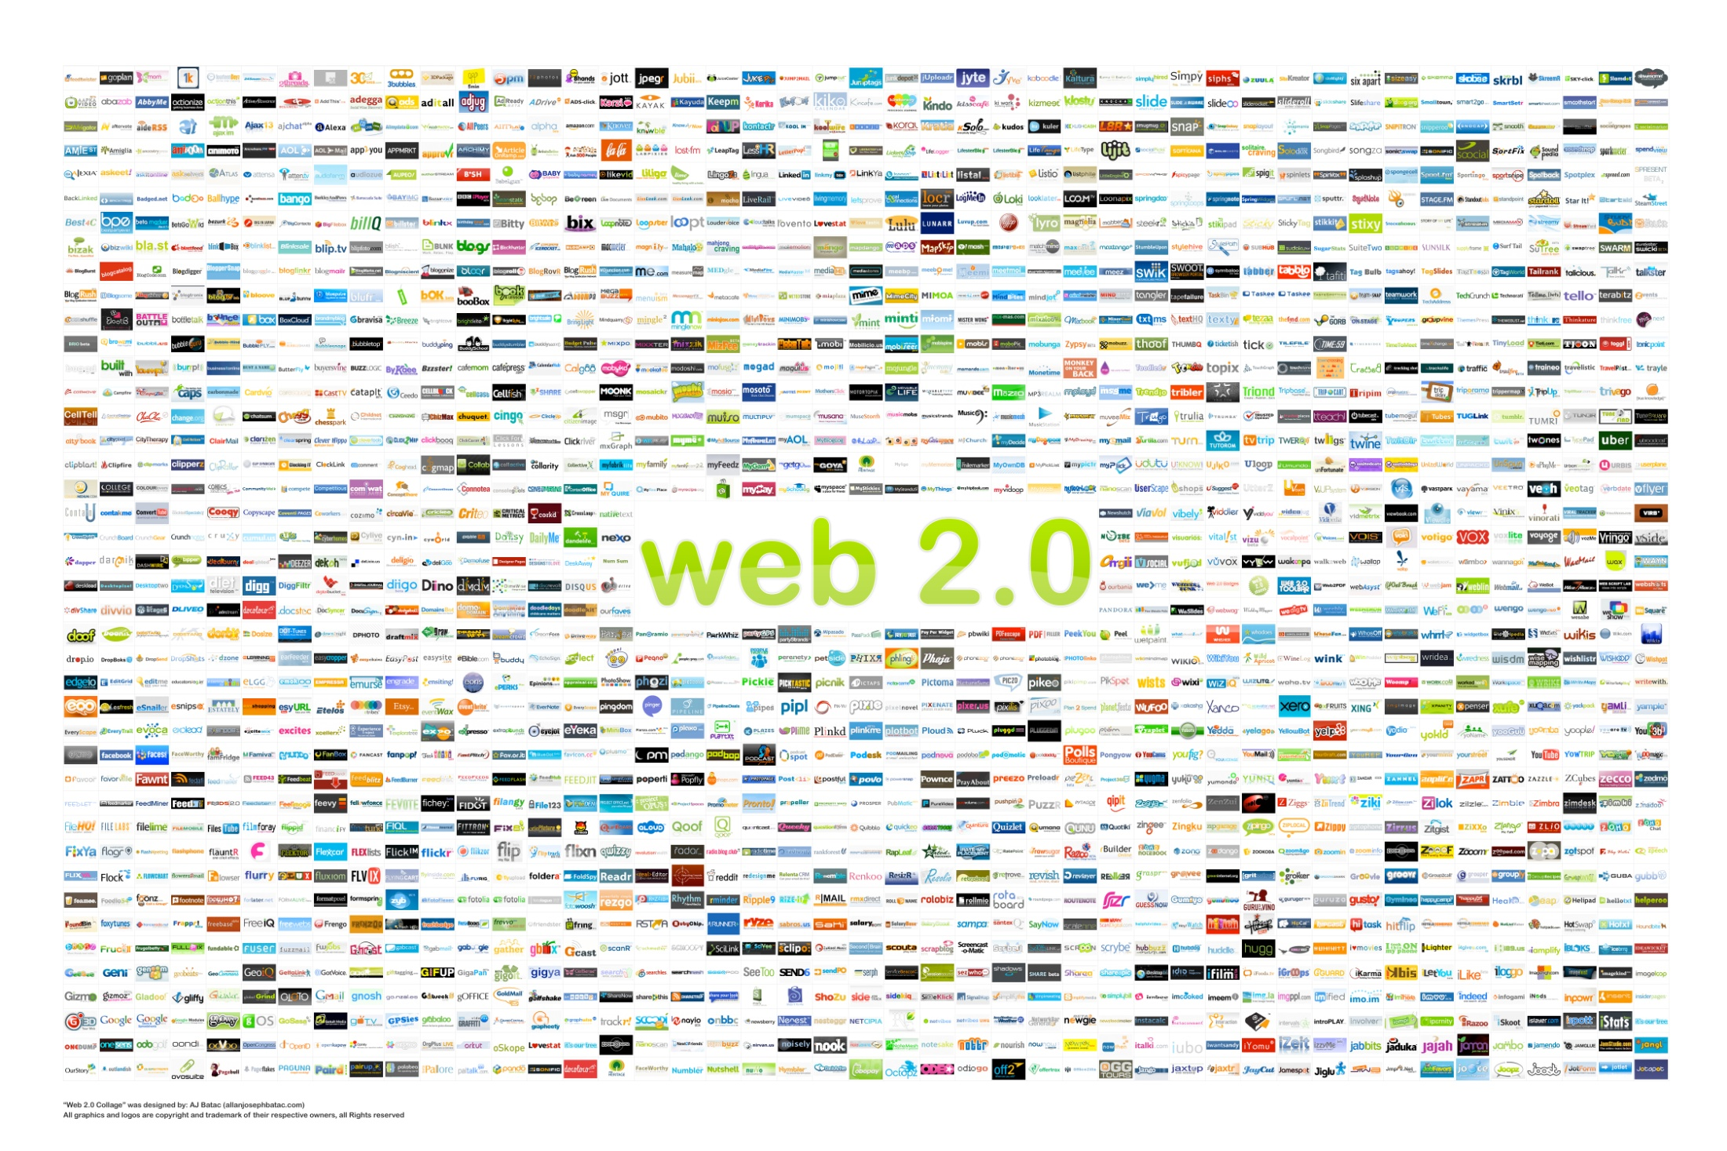
Notes:
Greater choice but also brings greater confusion
Need to support digital wisdom: management of data, sustainability.

Slide 7
Curriculum design
accreditation
Access
Interoperability
Flexibility
Strategic value
Connectivity
Useability
examinations
Institutional admininstrative procedures
Notes:
Sphere of influence vs sphere of concern (proactive focus, Stephen Covey)
Access: manage users, password management, security, standards
Interoperability: integrations, platforms,
Flexibility: fit for range of learning design
Strategic value: supports innovation, facilitates technically difficult tasks, encourages engagement
Connectivity: m learning, future proofing
Useability: short learning curves, support resources, dialogue with users

Slide 8
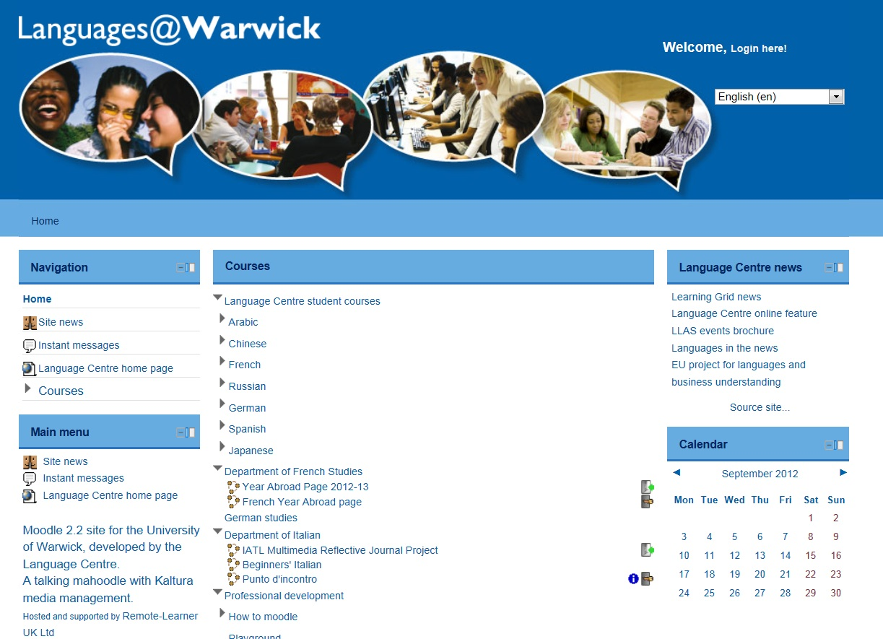
Notes:
Link into l@W to show EWC course, Punto d’incontro, 101, R1
Prioritises easy creation of interaction, use of voice, media management and creation, dialogue and CoP approach to e-learning

Slide 9
Partnerships

Slide 10
Projects and outputs:
Towards best practice for computer mediated communication
(more detail here)
E-portfolios for assessment
(see examples here)
Virtual Exchange #warcler and Clavier project
Case study for INTENT
HEA seminar and input into upcoming Collaboration event
Knowledge transfer: TDG project with Coventry University #MexCo
Dissemination channels:
Twitter: WarwickLanguage
Youtube: WarwickLanguage
Slideshare: Teresamac
Scoop.it: Teresamac

Slide 11
References:
Blake, R. 2008. Brave new digital classroom: Technology and Foreign Language Learning. Washington DC: Georgetown University Press.
Cummins, J. and Sayers, D. 1995. Brave new schools: Challenging cultural literacy though global learning networks. New York: St. Martin’s Press.
Helm, F. et al, 2012. Universities collaborating together online. Council of Europe Lifelong Learning Programme. Available at www.intent-project.eu
O’Rourke, B. 2005 Form-focussed interaction in online tandem learning. CALICO journal 22 (3):433-66.
Wenger, E. (2000), 'Community of practice and social learning systems',Organization, 7 (2), 225-246
Aguirre, S., & Quemada, J. (2012). E-learning Systems Support of Collaborative Agreements: A Theoretical Model. Educational Technology & Society, 15 (4), 279–295.

